Slide 1
Data Mining for Business Case I: OK Cupid
Al Sellaro
sellaro@sellaro.co

Slide 2
Business purpose
The goal is to support the marketing team in creating micro segments and personas for future campaigns

Slide 3
Data Analysis

Slide 4
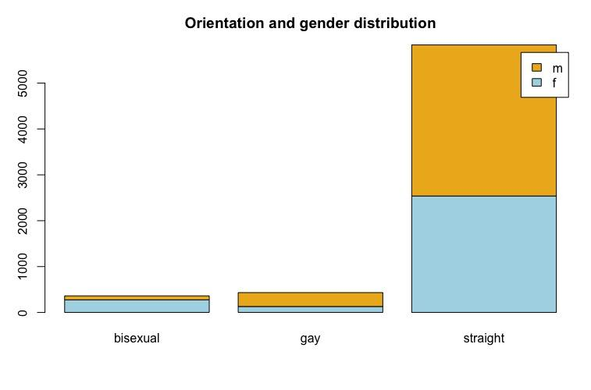
Orientation and gender
What is the distribution of gender and sexual orientation

Slide 5
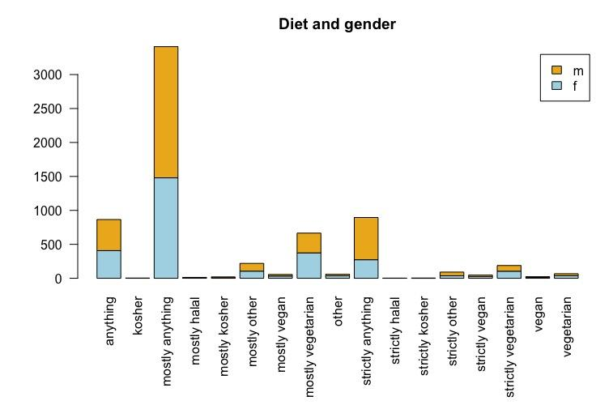
Diet and gender
What is the distribution of diet preference and gender

Slide 6
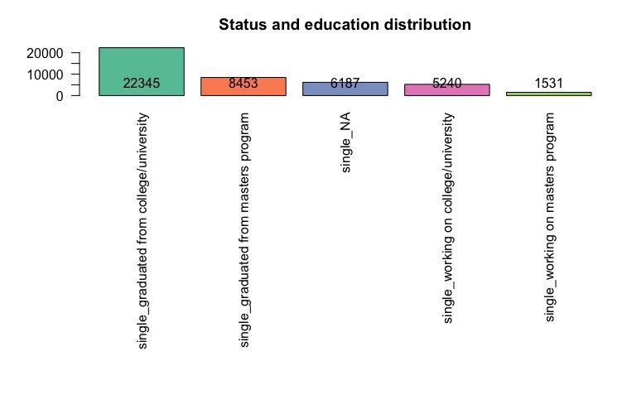
Status and education
Top 5 status and education mix

Slide 7
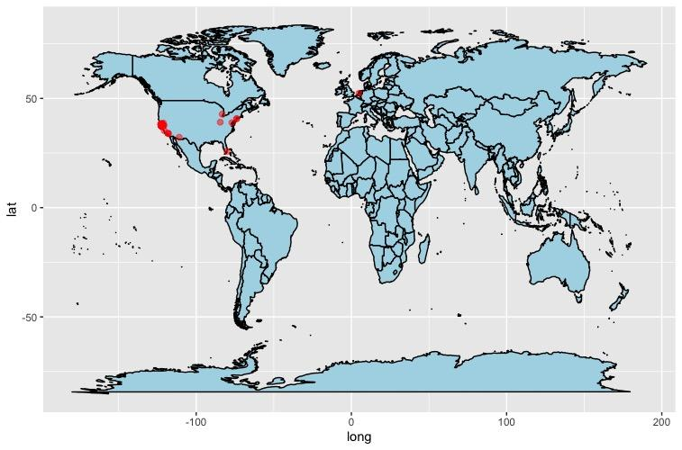
World users
Distribution of users around the world

